Slide 1
FLOW CHART SYMBOL
START the program
INPUT a value
OUTPUT on console
DECIDE something
PROCESS something
STOP the program

Slide 2
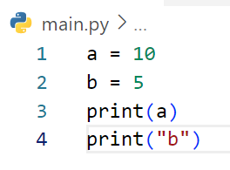
DRAW FLOWCHART
START
a = 10
b = 5
EXAMPLE
Print a
Print “b”
END

Slide 3
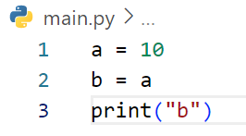
DRAW FLOWCHART
START
a = 10
b = a
print(“b”)
End

Slide 4
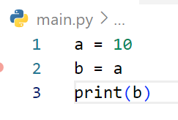
DRAW FLOWCHART
START
a = 10
b = a
print(b)
End

Slide 5
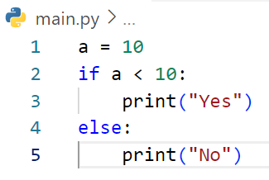
START
DRAW FLOWCHART
EXAMPLE
a = 10
No
a < 10?
Yes
Print “Yes”
Print “No”
END

Slide 6
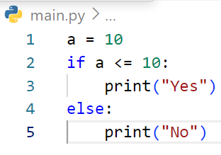
START
DRAW FLOWCHART
a = 10
a <= 10
Print “Yes”
Print “No”
END

Slide 7
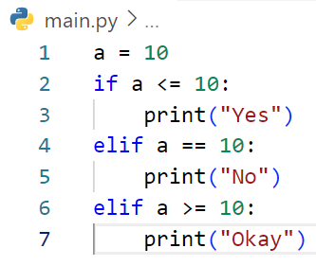
START
DRAW FLOWCHART
EXAMPLE
a = 10
No
a < 10?
a == 10?
No
Yes
Print “Yes”
Yes
a >= 10?
No
Print “No”
Yes
Print “Okay”
END

Slide 8
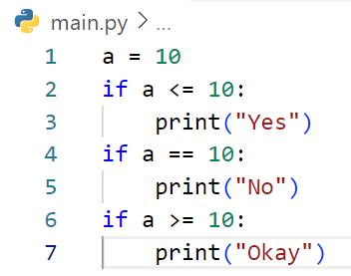
START
DRAW FLOWCHART
a = 10
a <= 10
No
Print “Yes”
a == 10
No
Print “No”
a >= 10
No
Print “Okay”
END

Slide 9
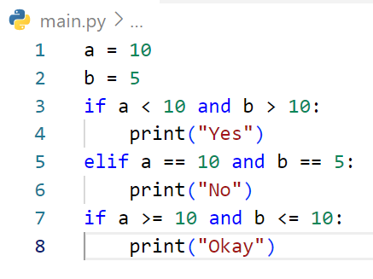
START
DRAW FLOWCHART
a = 10
b = 5
a <= 10 and b >10
No
a ==10 and b ==10
Print “Yes”
Print “No”
a >= 10 and b <=10
Print “Okay”
END

Slide 10
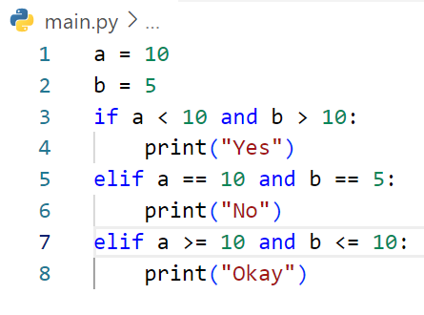
START
DRAW FLOWCHART
a = 10
b = 5
a < 10 and b >10
NO
a == 10 and b == 5
NO
Print “Yes”
a >= 10 and b <=10
NO
Print “No”
Print “Okay”
End

Slide 11
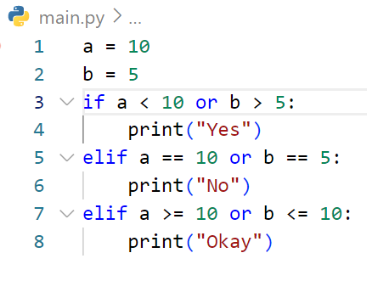
START
DRAW FLOWCHART
a = 10
b = 5
a < 10 or b >5
NO
a == 10 or b == 5
NO
Print “Yes”
a >= 10 or b <= 10
NO
Print “No”
Print “Okay”
End

Slide 12
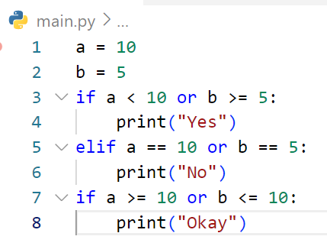
START
DRAW FLOWCHART
a = 10
b = 5
a < 10 or b >= 5
No
a == 10 or b == 5
Print “Yes”
Print “No”
a >= 10 and b <=10
No
Print “Okay”
END

Slide 13
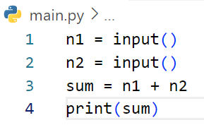
START
DRAW FLOWCHART
Get n1
Get n2
# If user enter first : 3 and second 5
sum = n1 + n2
EXAMPLE
Print sum
END

Slide 14
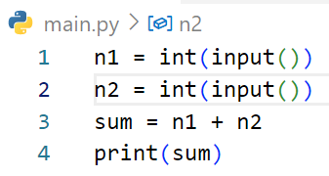
START
DRAW FLOWCHART
Get n1
Get n2
sum = n1 + n2
# If user enter first : 3 and second 5
Print sum
END

Slide 15
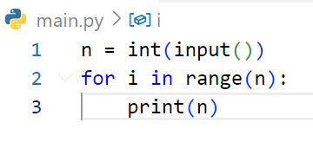
START
DRAW FLOWCHART
Get n
3
EXAMPLE
# If user enter : 3
Done
REPEAT n TIMES
Ongoing
Print n
END

Slide 16
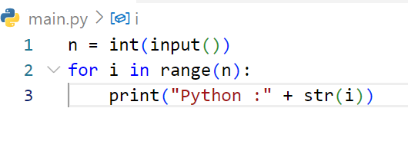
START
DRAW FLOWCHART
Get n
3
# If user enter : 3
Done
REPEAT n TIMES
Ongoing
Print “Python:” + str(i)
END

Slide 17
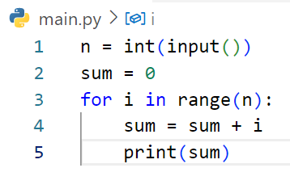
START
DRAW FLOWCHART
Get n
3
sum = 0
# If user enter : 3
Done
REPEAT n TIMES
Ongoing
sum = sum + 1
Print sum
END

Slide 18
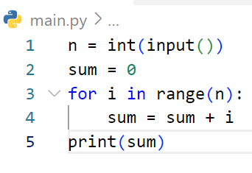
START
DRAW FLOWCHART
Get n
2
sum = 0
# If user enter : 2
Done
REPEAT n TIMES
Ongoing
sum = sum + i
Print sum
END

Slide 19
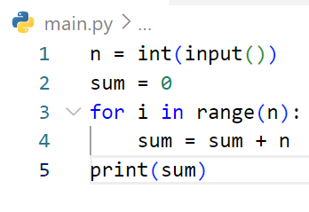
START
DRAW FLOWCHART
Get n
4
sum = 0
# If user enter : 4
Done
REPEAT n TIMES
Ongoing
sum = sum + n
Print sum
END

Slide 20
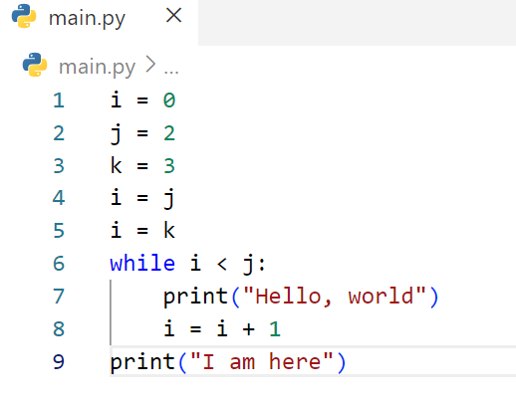
START
DRAW FLOWCHART
i = 0
j = 2
k = 3
i = j
i = k
i < j
False
Ongoing
Print “Hello, world”
i = i + 1
Print “I am here”
END

Slide 21
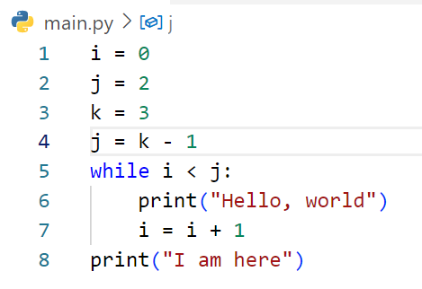
START
DRAW FLOWCHART
i = 0
j = 2
k = 3
j = k - 1
i < j
False
Ongoing
Print “Hello, world”
i = i + 1
Print “I am here”
END

Slide 22
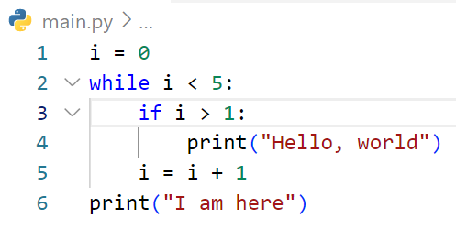
START
DRAW FLOWCHART
i = 0
i < 5
False
Ongoing
i > 1
No
Print “Hello, world”
i = i + 1
Print “I am here”
END

Slide 23
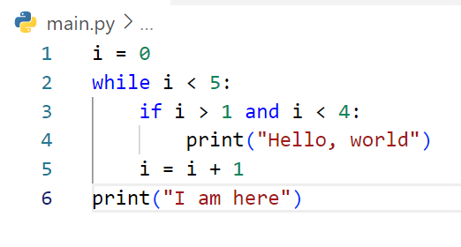
START
DRAW FLOWCHART
i = 0
i < 5
False
Ongoing
i > 1 and i < 4
No
Print “Hello, world”
i = i + 1
Print “I am here”
END

Slide 24
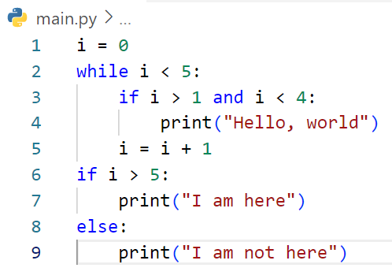
START
DRAW FLOWCHART
i = 0
i < 5
False
Ongoing
i > 1 and i < 4
No
Print “Hello, world”
i = i + 1
i > 5
No
Print “I am here”
Print “I am not here”
END

Slide 25
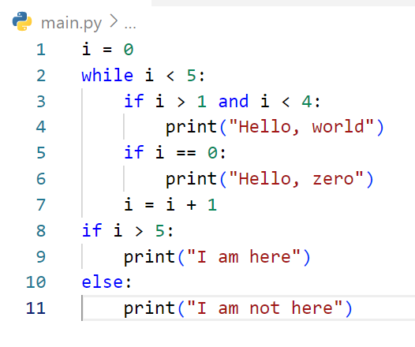
START
DRAW FLOWCHART
i = 0
i < 5
i > 5
No
False
Ongoing
i > 1 and i < 4
Print “I am here”
Print “I am not here”
No
Print “Hello, world”
END
i == 0
No
Print “Hello, zero”
i = i + 1

Slide 26
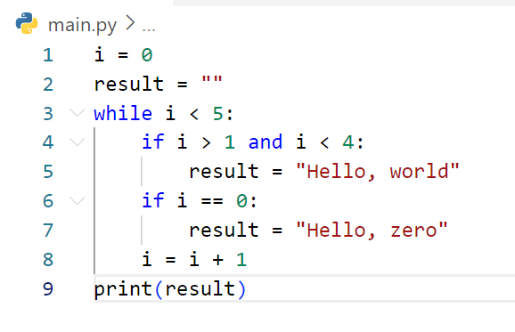
START
DRAW FLOWCHART
i = 0
i
i < 5
False
Ongoing
i > 1 and i < 4
No
Print “Hello, world”
i = i + 1
i > 5
No
Print “I am here”
Print “I am not here”
END

Slide 27
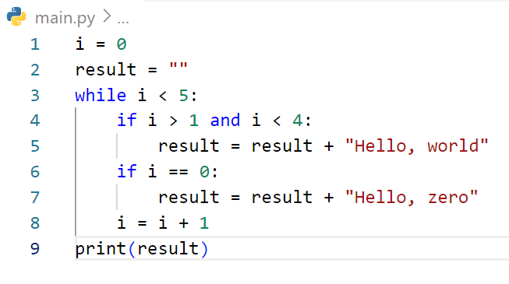
START
DRAW FLOWCHART
i = 0
Result = “”
i < 5
False
On going
i > 1 and i < 4
No
Result += “Hello, world”
Print Result
i == 0
No
END
Result += “Hello, zero”
i = i + 1

Slide 28
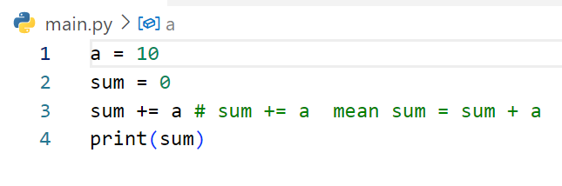
START
DRAW FLOWCHART
a = 10
sum = 0
sum += a
Print sum
END

Slide 29
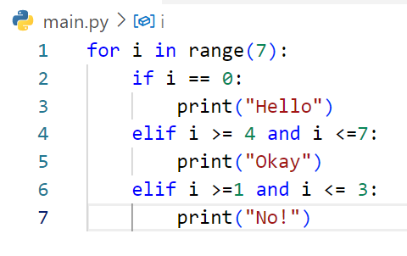
START
DRAW FLOWCHART
7
done
i == 0
No
END
Print Hello
i >= 4 and i <= 7
No
Print Okay
i >= 1 and i <= 3
No
Print No

Slide 30
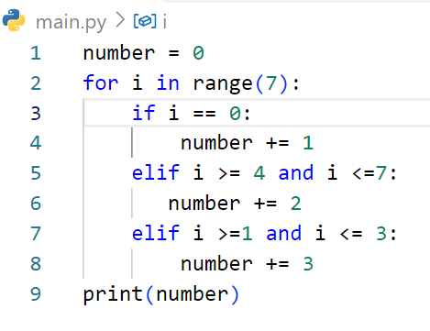
START
DRAW FLOWCHART
Number = 0
7
done
Print Number
i == 0
No
END
Number += 1
i >= 4 and i <= 7
No
Number += 2
i >= 1 and i <= 3
Number += 3

Slide 31
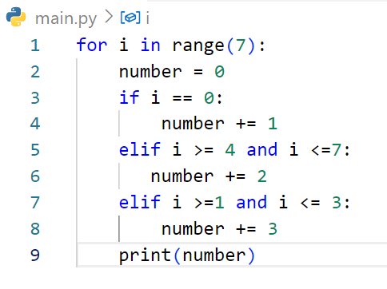
START
DRAW FLOWCHART
7
done
Number = 0
No
i == 0
END
Number += 1
No
i >= 4 and i <= 7
Number += 2
i >= 1 and i <= 3
Number += 3
Print Number

Slide 32
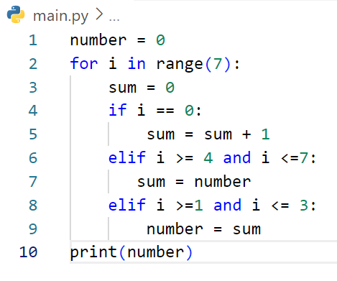
START
DRAW FLOWCHART
Number = 0
7
done
Print Number
Sum = 0
END
i == 0
No
Sum += 1
No
i >= 4 and i <= 7
Sum = Number
i >= 1 and i <= 3
Number = Sum

Slide 33
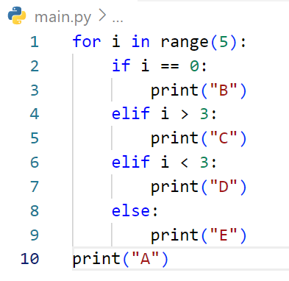
START
DRAW FLOWCHART
5
done
Print A
i == 0
No
END
Print B
i > 3
No
Print C
i < 3
No
Print D
Print E

Slide 34
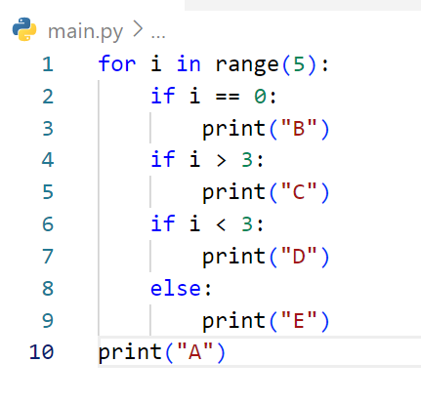
START
DRAW FLOWCHART
5
done
Print A
i == 0
No
END
Print B
i > 3
No
Print C
i < 3
No
Print D
Print E

Slide 35
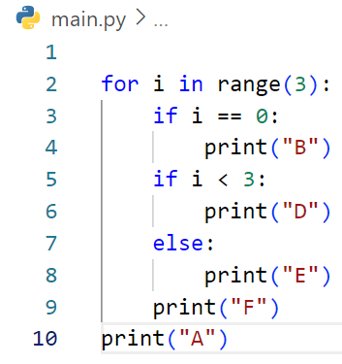
START
DRAW FLOWCHART
3
Done
i == 0
No
Print F
Print B
End
i < 3
No
Print E
Print D
Print F

Slide 36
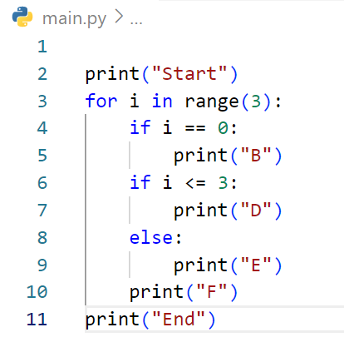
START
DRAW FLOWCHART
Print Start
3
Done
i == 0
No
Print F
Print B
End
i < 3
No
Print E
Print D
Print F

Slide 37
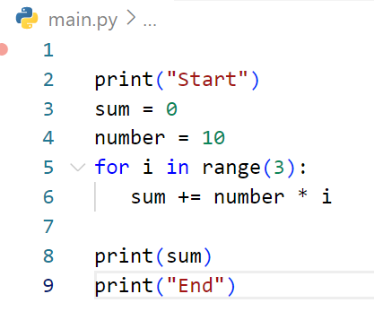
START
DRAW FLOWCHART
Print Start
Sum = 0
Number = 10
3
Done
Sum += Number *1
Print Sum
Print End
END

Slide 38
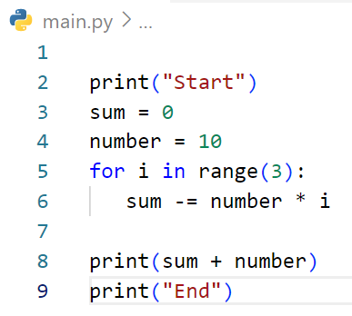
START
DRAW FLOWCHART
Print Start
Sum = 0
Number = 10
3
Done
Sum += Number *1
Print Sum + Number
Print End
END

Slide 39
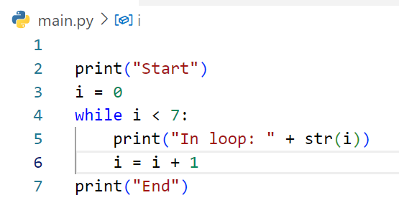
START
DRAW FLOWCHART
Print Start
i = 0
i < 7
Done
Print In loop: + str (i)
i = i + 1
Print End
END

Slide 40
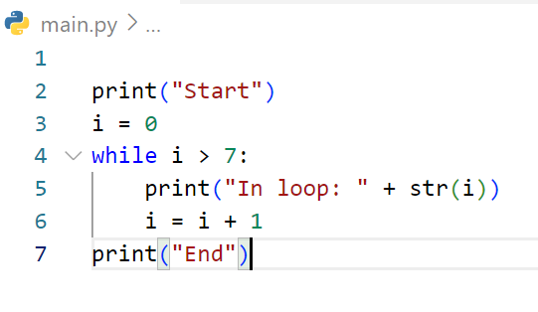
START
DRAW FLOWCHART
Print Start
i = 0
i > 7
Done
Print In loop: + str (i)
i = i + 1
Print End
END

Slide 41
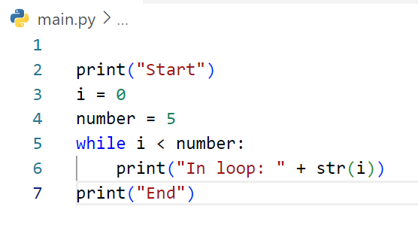
START
DRAW FLOWCHART
Print Start
i = 0
Number = 5
i < Number
Done
Print In loop: + str (i)
Print End
END

Slide 42
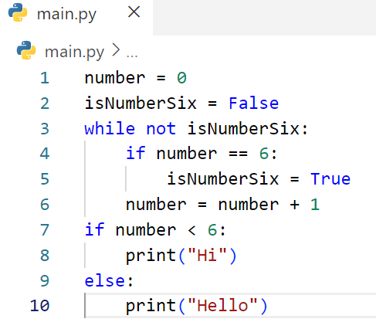
START
DRAW FLOWCHART
Number = 0
isNumberSix = False
Not isNumberSix
False
Number == 6
No
Number == 6
No
isNumberSix = True
Print Hi
Number += 1
Print Hello
START

